Slide 1
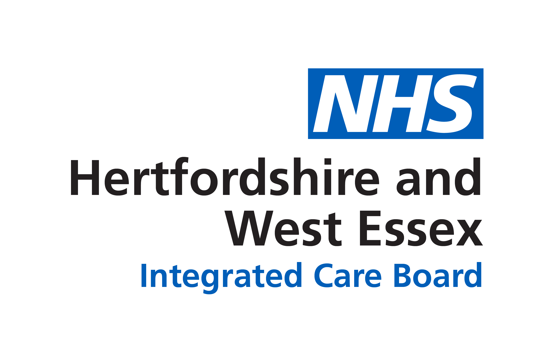
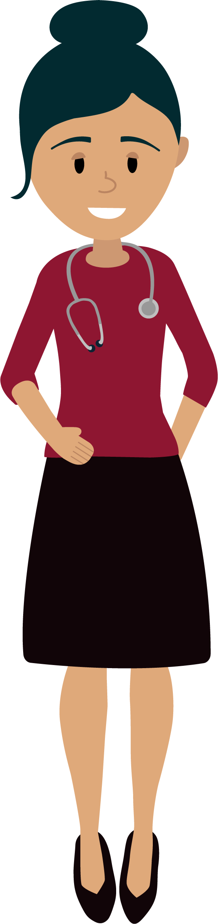
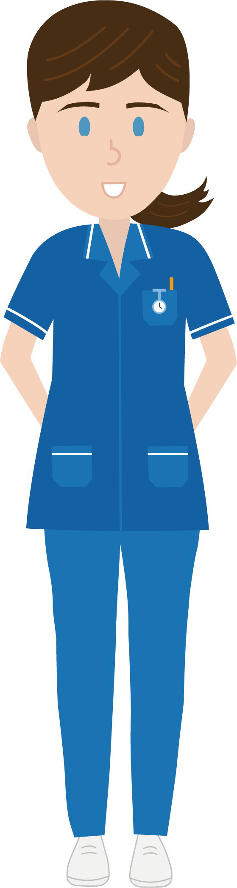
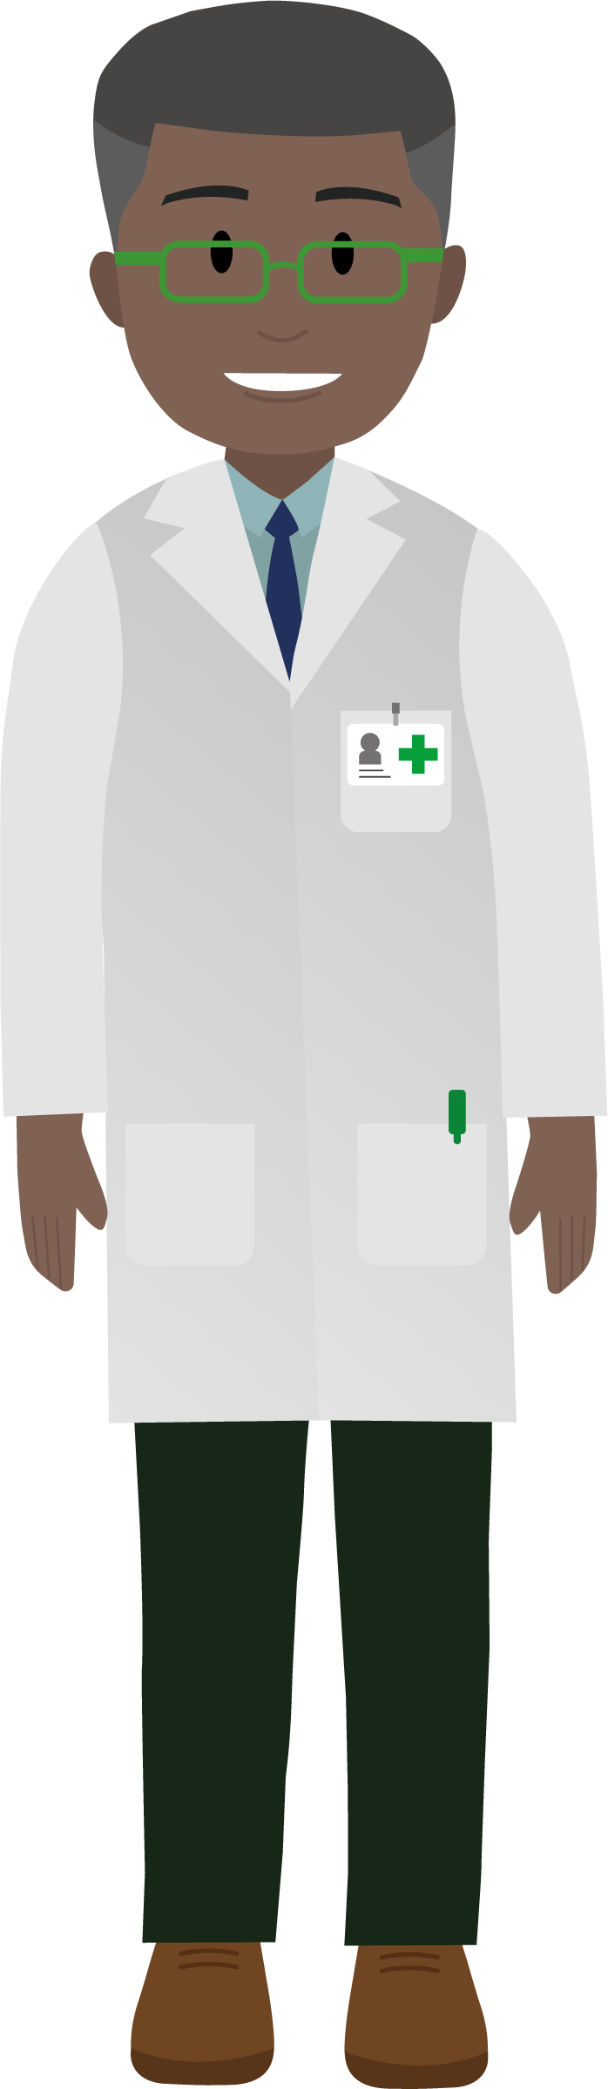
Young Persons Link Worker Ben
Works with young people aged 11-25 to provide support for those to access community- based services for mental health and general well-being issues.
Social Prescribers
Simon, Guppy, Linda
The team offer personalised, practical support around housing, benefits, debt, social isolation, bereavement and help connect patients to local community services.
Much Hadham Health Centre
Ash Meadow, Much Hadham, SG10 6DE
01279 842242 much.hadham@nhs.net
Dietitian
Julie
Specialising in nutrition, she provides expert advice on diet for health improvement, disease management and prevention. Patients are referred by the GP.
Occupational Therapist
Jacqui
Specialising in ASD and ADHD she supports patients using sensory techniques and helps families with coping mechanisms while they wait for their assessment / diagnosis.
Additional roles at the Health Centre
Health and Well-being Coach Ollie
Coaching patients to take control of their health through lifestyle and behaviour changes linking this to fitness and exercise. He works with patients to develop personalised plans focusing on improving physical and mental well-being.
GP Assistant
Kathryn
Assisting in the day to day operations of GP practice, supporting GPs and other clinicians with administrative tasks, patient care, referrals to secondary care, management of patient records and communication.
General practice has changed over the years.
Traditionally patients used to see the GP for all ailments. Now patients can see other clinicians who are able to offer treatment and support from the first contact.
When you contact the practice our experienced reception team will ask for a few details to ensure you are placed with the right health care professional.
‘Ensuring you get the care you need, when you need it’
Produced by NHS Hertfordshire and West Essex ICB July 2024for their needs, visit XXXXXX

Slide 2
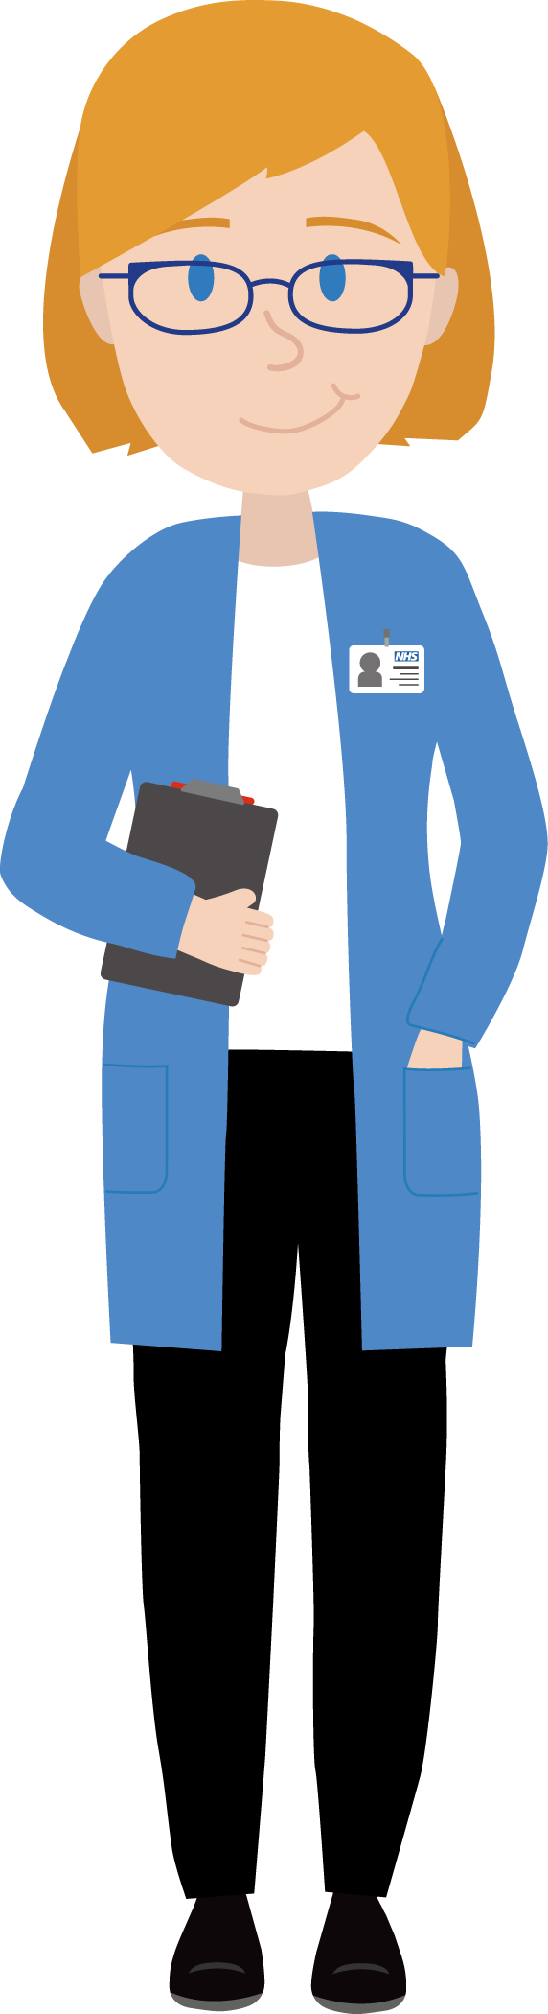
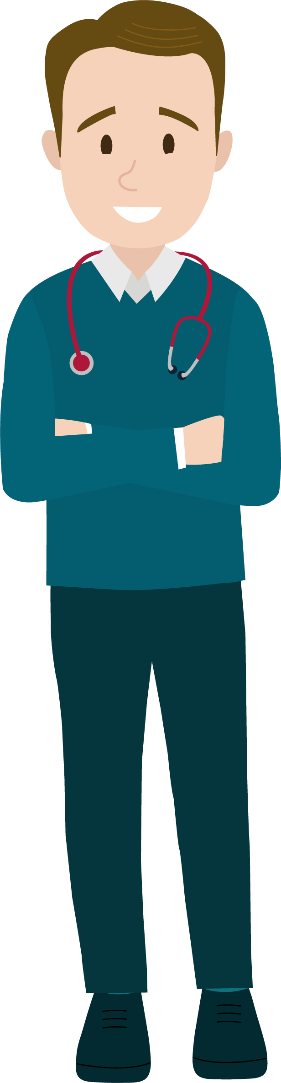
Advanced Nurse Practitioner Bonny
Works alongside GPs and other practice staff to provide care to both adults and children for minor illness. She can prescribe medication, order tests, interpret results, diagnose your health problems and organise and create an appropriate treatment plan.
Community Paramedic
Tina
Visits patients who are housebound or unable to attend the practice with chronic health conditions. She will also visit elderly, frail patients who have not attended for some time, providing a health check, take bloods, review medication and refer for support if required.
When you’re feeling unwell, you want to get advice and help quickly.
General practice is often the front door into NHS services and the way that people get health advice, information, treatment and support.
So that you can get the right care at the right time, there are different specialist roles in general practice working together to care for you. The clinicians work at your practice and across a group of practices in your area, which is called a primary care network.
We want to support you to get the right appointment for your needs. You could be offered an appointment with a nurse, a paramedic, a pharmacist, a physiotherapist or another role rather than a GP if this is the best person to help you.
Clinical Pharmacist
Dilusha
Assess and treat patients using her expert knowledge of medicines. If you are taking several medications, she can ensure they are working well together and manage any side effects. She supports medicines optimisation and will offer reviews to patients and care homes.
Pharmacy Technician
Jacqueline
Compliments the work of the clinical pharmacist by applying her pharmaceutical knowledge to audits and dealing with medication requests from patients and hospital settings. Reviews patient medications and requests blood tests for medication monitoring.
This larger team also means GPs have more time to treat those with more complex or chronic health conditions. If you need to see a GP you will always be offered an appointment, but these other health professionals may be able to provide more appropriate support so please take the opportunity to have an appointment with them.
There are different ways you can make an appointment with us:
    Telephone
      Urgent appointment on the day from 8.30am
      Routine appointment call after 9.30am
    Contact us form on website
    NHS App
Physiotherapists
Phillip, Edwin, Dan
For patients who have a problem that affects their neck, back, joints, muscles and nerve pain. They have advanced skills to assess, diagnose and recommend appropriate treatment which may include exercises, referral for imaging, bloods or medication. First contact is initially by telephone.
Mental Health Practitioner
Mal
Works with adults with mild to moderate mental health problems including low mood, anxiety, stress, depression and sleep issues. Following initial telephone assessment, she will see patients face to face locally for counselling and treatment.

