Slide 1
Dermoscopy Toolkit
Guide to using DermLite DL4
Herts and West Essex ICB
(South and West Herts)
June 2024

Slide 2
ABOUT THIS TOOLKIT
This toolkit has been created for practices in South West Herts to help support the use of dermoscopy and to promote the use of dermoscopic images to support dermatology referrals. A GP questionnaire was carried out to gain insight into the limitations and challenges faced by practices in sending dermatoscopic images and a common theme identified was the lack of confidence in the use of the dermatoscope. In response, this toolkit has been created to support practice staff with a step by step guide to taking dermoscopic images and photographing lesions, as well as suggestions on how to capture the best image.
GP Practices in SW Herts have been supplied with a DermLite D4 dermatoscope and this toolkit and at times this toolkit specifically refers to the use of the DL4.
Please remember you only need to take a clear and focused dermoscopic image and attach it to the referral. You do not need to interpret the image.

Slide 3
CONTENTS PAGE
Slide 4 Why take a Dermoscopy Image? and video link
Slide 8 Top Tips for using a Dermoscopy in Primary Care
Slide 9 Introduction to the DermLite DL4
Slide 10 Summary of How to Use DermLite DL4
Slide 12 Light Features : Polarised and Non-Polarised Light
Slide 13 Light Features : Pigment Boost
Slide 14 Light Features : Pigment Boost & Polarised LEDs
Slide 15 Polarised vs Non-Polarised Dermoscopy and video link
Slide 16 When to use Polarised or Non-Polarised Light?
Slide 17 Non-Polarised vs Polarised Dermoscopy
Slide 18 When to use Liquids?
Slide 19 Liquids that can be used
Slide 20 Taking Dermoscopy Images – Getting Read
Slide 21 How to take a Dermoscopy Image?
Slide 22 Clinical Photos – Take 2 Images
Slide 23 Auto Focusing on the Lesion & Lighting
Slide 24 Sending your Photos
Slide 25 Pando App – Secure App on Smartphone/iPod
Slide 26 Pando App and link
Slide 27 Sending Images using the Pando App

Slide 4
WHY TAKE A DERMOSCOPY IMAGE?
Reduce inappropriate referrals to the Urgent Suspected Skin Cancer Pathway and make the best use of clinical capacity.
Allow triage of referrals more efficiently.
Provide rapid reassurance for GPs and patients.
Allows you to keep a clear record of the lesion with measurements in the patients notes for future comparison.
Remember : You only need to capture the dermoscopy image and attach it to the referral. You do not need to interpret the image.
The videos below demonstrate How to use DermLite DL4 Dermatoscope https://www.youtube.com/watch?v=QaWh_Ml3DOo Dermlite DL4 Dermatoscope (youtube.com)

Slide 5
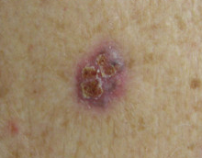
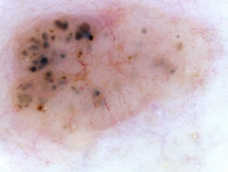
WHY DERMOSCOPY HELPS Cont/….
Macro Image
Dermoscopy Image

Slide 6
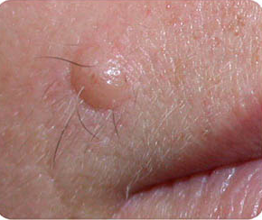
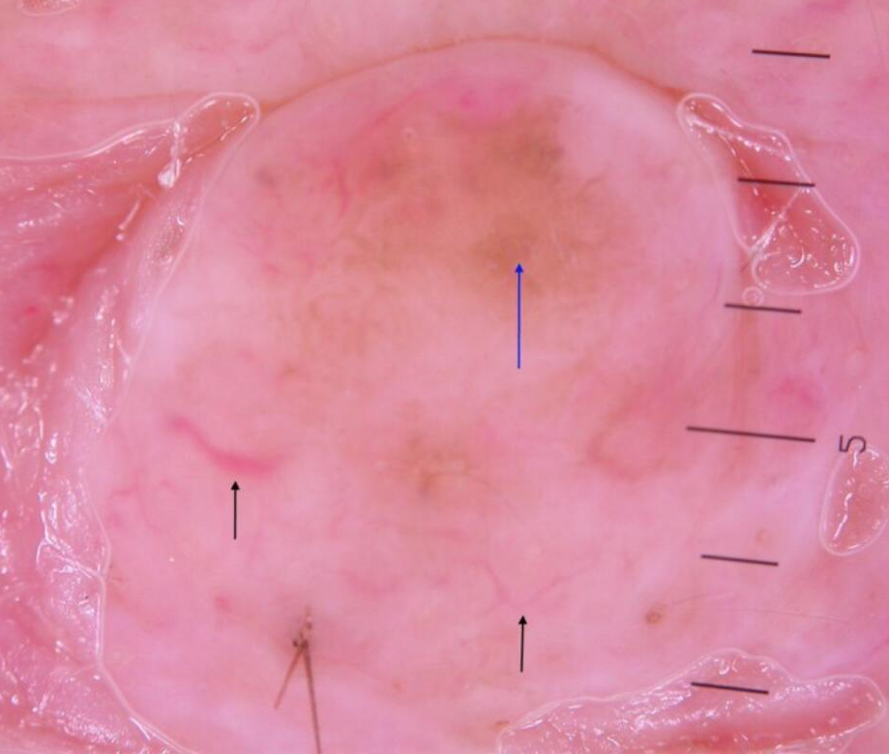
WHY DERMOSCOPY HELPS Cont/….
Macro Image
Dermoscopy Image

Slide 7
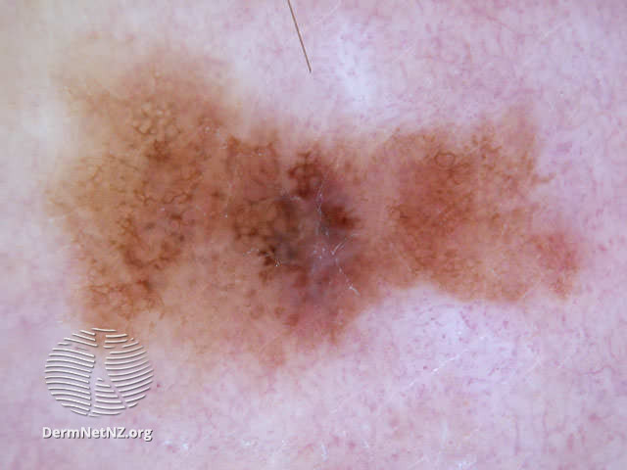
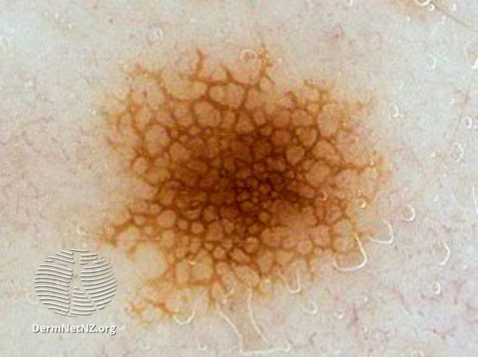
WHY DERMOSCOPY HELPS Cont/….
Malignant melanoma
Junctional Naevus

Slide 8
TOP TIPS FOR USING DERMOSCOPY IN PRIMARY CARE
If you use a triage system, arrange the patient’s appointment at a time the dermatoscope is available. It normally takes 5-10 minutes to take an image
Images can be taken by any trained clinical staff and admin staff can upload the image to save time
Keep your equipment charged and stored in a (secure) central location where it can be accessed easily
Consider keeping a sign in sheet for the dermatoscope so its location is always known
Familiarise yourself with the equipment and practice using it
Check the lesion is in focus on the dermatoscope before capturing and sending the image
Polarised / non-polarised / pigment boost : the best image to send is the one that shows up the lesion most clearly
Using liquids to enhance the image quality is optional, not necessary if the image is clear.

Slide 9
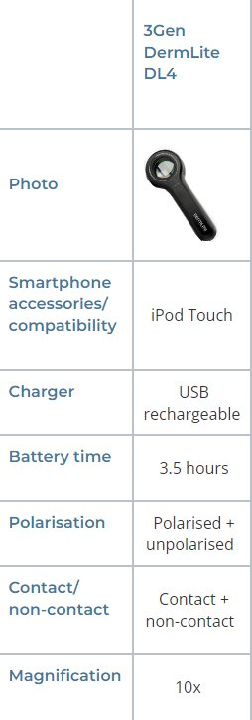
INTRODUCTION TO THE DERMLITE DL4
The DermLite DL4 is a smartphone-compatible pocket dermatoscope designed to view skin lesions with high magnification and clarity.
Two set of white LEDS (light emitting diodes) can be activated independently:
  one set of LEDs provides cross-polarized light (by cancelling the reflected light from the skin)
  other set of LEDs provides non-polarised light for traditional immersion fluid dermoscopy.
A special PigmentBoostTM button (PB) activates a third set of LEDS.
A high-quality 1- x lens with superb colour correction and reduced image distortion produces an image rich in surface detail. To facilitate the use of immersion fluids, and allow for smartphone dermoscopy, the unit is equipped with a retractable faceplate spacer.

Slide 10
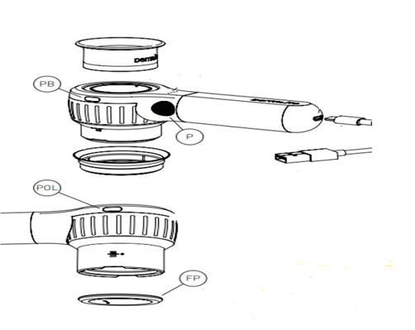
SUMMARY OF HOW TO USE DERMLITE DL4
Hold your DermLite DL4 so that the LEDs are aimed in the direction of the lesion to be examined.
2. Place the device approx. 1” from the skin.
3. Push the power button (P)– located at the left side of the handle, to turn on the device (SHORT PRESS) or push the two mode buttons (POL & PB), located at the head, simultaneously.
4. The device will always come on in polarised mode – you can toggle between polarised and non-polarised mode by pressing the (P) button or the (POL) button. Push and hold for about 1 second to toggle between two brightness levels. Polarised light mode is the most frequently used.
5. Press (PB) briefly to activate PigmentBoost lighting in addition to white light. To enter the exclusively orange PigmentBoost mode, press the button (PB) for about 1 second; briefly press (PB) or (POL) to exit.
6. Look through the lens with your eye placed about 1 to 2” (25-50 mm) above your DermLite. Move the device closer or further away from the skin to obtain the desired image focus.

Slide 11
SUMMARY Cont/….
7. For dermoscopy with skin contact, or for camera use, rotate the Focus Dial (FD) to focus the image. The position “0” indicates the ideal distance for photography.
8. To turn off your DermLite, push the power button (P) for about 1 sec. or push the two mode buttons (POL & PB), located at the head, simultaneously. To save power, the unit automatically turns off after 3 minutes

Slide 12
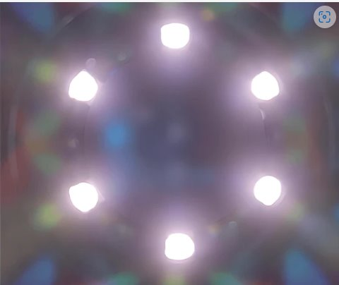
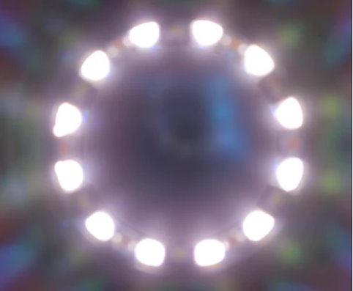
LIGHT FEATURES : POLARISED AND NON-POLARISED LIGHT
Non-Polarised Mode (without PigmentBoost)
There are six white LEDs in total.
Polarised Mode (without PigmentBoost)
Once switched to polarised mode, the DL4 activates a total of 12 LEDS
Non-polarised mode is looking at the surface features, it’s used less often.

Slide 13
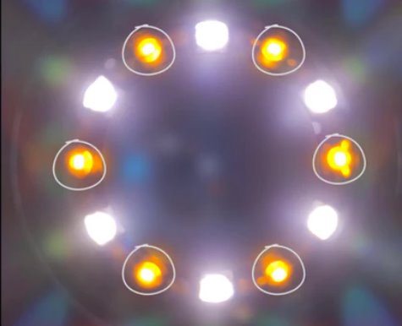
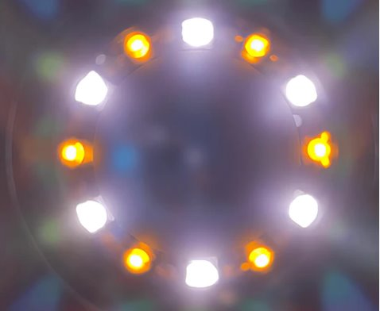
LIGHT FEATURES : PIGMENT BOOST
Pigment Boost Lighting
PigmentBoost lighting is created by these orange-amber coloured LEDs. They add an extra element of colour to the visualisation of pigment structures
Pigment Boost & Non Polarised LEDs
In non-polarised mode with the addition of PigmentBoost, we see six white LEDs as well as six amber-orange Pigment Boost LEDs
Because non-polarised mode is looking at the surface features, it’s used much less often when evaluating pigmented lesions.

Slide 14
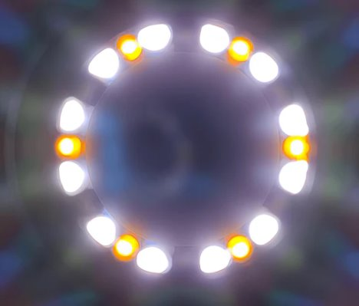
LIGHT FEATURES : PIGMENT BOOST & POLARISED LEDS
Pigment Boost & Polarised LEDS
Polarised light mode is the most frequently used.
In polarised light mode with PigmentBoost activated, we see 12 white LEDs, along with the six amber-orange LEDs, so that give us a total of 18 LEDs activated.

Slide 15
POLARISED vs NON-POLARISED LIGHT
Cross-polarisation removes light reflected by the skin surface, enabling you to see lesion structures. Non-polarised light requires a glass contact plate and a liquid to see structures with sufficient clarity.
You need to try out the dermatoscope and experiment with the lights functions to find out which gives you the clearest picture. Remember the aim is to take the best quality image possible.
The videos below may also be helpful:
You Tube Video : Dermlite DL4 - How to Use (youtube.com)
Dermlite DL4 Dermatoscope - What is PigmentBoost? - YouTube

Slide 16
WHEN TO USE POLARISED or NON-POLARISED LIGHT?
Polarised Light Mode :
Vascular Structures : Helps in visualising blood vessels and other vascular structures more clearly.
Pigmented Lesions : Such as melanomas, as it provides better contract and details.
Deeper Structures : Can penetrate deeper into the skin, making it useful for seeing structures beneath the surface.
Reducing Flare : Making it easier to see details without being distracted by reflections from the skin surface
Non-Polarised Light Mode :
Surface Details : Better for examining surface details such as scales, crusts & epidermal patterns.
Reflected Light : It provides a better view of the light reflected directly from the skin surface, which can be helpful in assessing the texture and superficial characteristics of lesions.
Immediate Diagnosis : Sometimes, switching to non-polarised light can provide immediate diagnostic clues by highlighting different aspects of the skin structure.
Dual Mode Comparison : Switching between the two lights can provide a comprehensive understanding of the lesion by revealing different characteristics.

Slide 17
NON-POLARISED vs POLARISED DERMOSCOPY
Non-polarised dermoscopy | Polarised dermoscopy
Requires contact with skin surface | No contact needed
Requires interface fluid | No interface fluid needed
Better visualisation of superficial structures e.g. comedo-like openings, milia-like cysts, crypts, blue-white veil | Better visualisation of variable pigmentation and dermal vessels White lines/streaks/crystalline structures only seen with polarised light – new or remodelled collagen

Slide 18
WHEN TO USE LIQUIDS?
Using liquid may be beneficial in non-polarised mode, to enhance the clarity of superficial skin structures.
Below are specific situations when you might use liquids :
Non-Polarised Dermoscopy : Liquid helps reduce surface reflections and glare, allowing better visualisation of superficial structures such as scales, surface patterns and small pigmentation details.
Dry or Scaly Lesions : Applying liquid can help smooth out the surface, providing a clearer view of the lesion.
Uneven Skin Surface: if the skin surface is uneven or dry, applying liquid to the lesion can improve the contact between the dermatoscope and the skin, resulting in better images.

Slide 19
LIQUIDS THAT CAN BE USED
A variety of liquids can be used to enhance visualisation of the skin lesions but are not essential. Some common options include:
1. Water based lubricant gel: While it may not provide the same level of clarity or enhancement as some other fluids like mineral oil or glycerine-water mixtures, it can improve image quality and is readily available in consulting rooms.
2. Mineral oil: It is often used as a lubricant and provides a clear view of the skin surface.
3. Alcohol: It can be used as a quick-drying agent to remove oils from the skin and improve contact between the dermoscopy and the skin.
4. Glycerin: When mixed with water, glycerin can create a clear, viscous solution that helps improve visualisation
5. Water: Plain water can be used in some cases, although it may not provide as much clarity or enhancement as other fluids.
6. Ultrasound gel: This gel is clear and can improve visualisation.
Some water-based lubricants may evaporate quickly, so it’s important to monitor and reapply as needed during the examination.
The choice of liquid may depend on factors such as the type of lesion being examined, the preferences of the clinician, and the those available.

Slide 20
TAKING DERMOSCOPY IMAGES – GETTING READY
Make sure the end plate of the scope is clean on both sides.
Remove any surface crust or scale from the lesion, either with a damp cloth, or by tape stripping (apply opaque sticky tape to the lesion, remove it, repeat until the tape comes away clear). Sometimes an adherent crust or scale needs softening with emollient before it can be removed, it is preferable to do this first. Urea based emollients can be helpful to remove surface scale. Once the crust has been removed, we can see what lies beneath.
Make sure you have the patient’s consent - verbal consent is fine if you are only using the image for their direct medical care, but if using photos for any other purposes (e.g. teaching) then a consent form should be used. You should always inform the patient that the photos will be stored in their clinical record, and ideally show them any photos before uploading them.

Slide 21
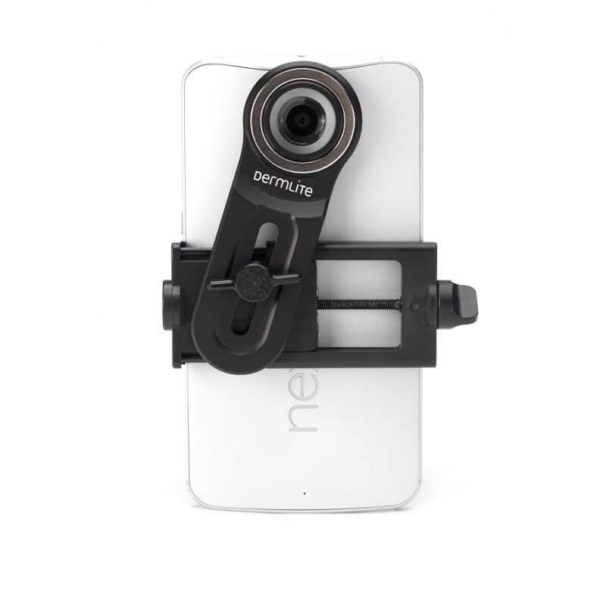
HOW TO TAKE A DERMOSCOPY IMAGE?
Attach the DL4 to your smartphone using the smartphone/iPod adapter.
Align the dermatoscope’s lens with your smartphone/iPod camera lens and secure it in place.
Press the power button to turn on the device (power button (P) – located on the left side of the handle). Adjust the brightness as needed using the controls on the DL4.
For contact – (for pigmented lesions) Place the DL4’s lens directly on the skin ensuring it is in full contact.
For non-contact – Hold 1” away from the lesion.
Twist the dermatoscope lens until the lesion is in focus.
Open the camera app on your smartphone/iPod. You may need to adjust the image on the device to ensure the image is clear.
Capture the image by pressing the shutter button.
Check the image for clarity and detail. Retake if need be.
Clean equipment by using alcohol wipes before next patient.

Slide 22
CLINICAL PHOTOS – TAKE 2 IMAGES
Always take at least 2 macro photos for each lesion, in addition to the dermoscopy photo:
An orientation photo: stand 1 metre away from the area of interest and take the photo. This shows where the problem is and how big an area it covers - if making a referral this can help the specialist decide if the lesion is small enough to excise with a simple ellipse, or if it may need a skin flap/graft.
A close-up photo: move your camera 10-12cm from the skin problem. On most phones or iPod you can touch the part of the screen you want the camera to focus on. If you get too close, the camera won’t be able to focus. The focus is the most important thing - don’t worry about getting really close, as close as you can get in order to achieve a sharp focus is all you need. For the close up photo, it is usually better to have the light source coming slightly from the side, to highlight any change in skin texture.
A sideways on photo is needed for a raised lesion: if the lesion is raised then a sideways on photo is very helpful.

Slide 23
AUTO FOCUSING ON THE LESION & LIGHTING
Images must be in focus for the dermatologist to review
Most smartphone/iPod cameras have a built-in auto focus feature. You may need to wait a second for the auto-focus to find the lesion.
If your camera is too close to the lesion this usually results in an out of focus photograph.
Try zooming in from a bit further back.
Good overhead lighting is ideal
General office or household light may not always be sufficient to light an image.
Considering using a flash or other lighting to improve the image quality if necessary.

Slide 24
SENDING YOUR PHOTOS
Only send the best photos of each skin lesion
Make sure the picture file size is between 500Kb and 1Mb
If you took the photo within a dedicated app (this is the best way to do it when using a phone/iPod), then most of the apps will automatically resize the photo for you. There are many different apps available. One example in the UK is Pando (which is free to use but you need a nhs.net email to do so)
Otherwise, if you have the photo saved on your desktop, you can open it in “paint” (on all Microsoft computers) and click on “resize”. This lets you choose a percentage. 20% is usually about right, but you can check what the file size has been changed to by saving it, and then hovering over the icon or file name on your desktop
Alternatively, you may be able to choose the file size when emailing it to yourself (refer to the BAD guidelines https://cdn.bad.org.uk/uploads/2022/02/29200021/Teledermatology-Quality-Standards.pdf).

Slide 25
PANDO APP – SECURE APP ON SMARTPHONE or IPOD
The Pando App (free to download) allows photographs to be taken in a confidential and secure manner, that meets data protection requirements.
There is no need to alter the settings on your smartphone/iPod. The photos are not stored on the device itself but in a secure cloud.
The app automatically saves photos in the correct file size for upload.
App sends the photos directly to the NHS email address that have been set up with the account.

Slide 26
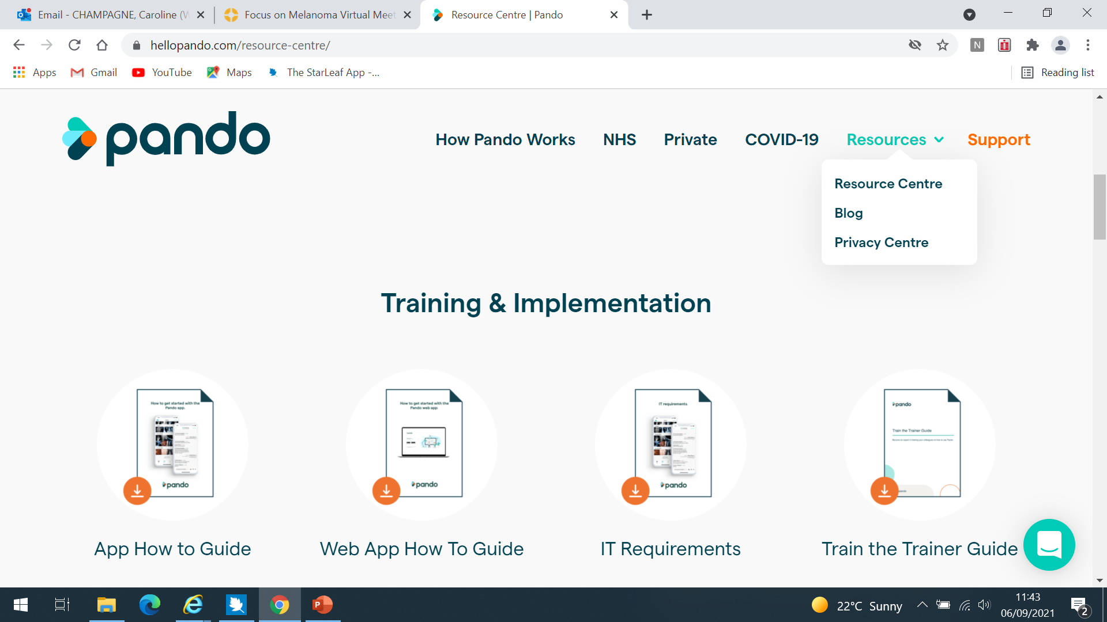
PANDO APP
Pando | Secure Messaging for Healthcare Professionals (hellopando.com)

Slide 27
SENDING IMAGES USING THE PANDO APP
ENSURE THE iPOD IS CONNECTED TO WiFi
Enter Pando App
Click List (at bottom of screen)
Click '+' at top right
Click 'More Info' at top right
Click PATIENT INFO in middle of screen
Enter First Name, Last Name, Date of Birth, gender, (you may wish to scroll down to also add EMIS number to Organisation Number)
Click camera at bottom of page & take photo
Use Photo (or retake if poor quality image)
Take another photo - Use or retake again. Repeat as needed
Please take a couple of macro images by sliding your dermatoscope away from your camera lens (one distant enough to indicate part of body, one close up) and at least one dermoscopy image after sliding the scope & adaptor back
Then click the email button (bottom left)
This sends an email to the nominated address with the entered patient info as well as all the images
Delete the patient (bottom right) which will clear all the images.
Return the equipment to its secure place and ensure it is sufficiently charged ready for the next user.

Slide 28
CONTACTS
If you have any questions around the use of dermoscopy or need some support to use the equipment, please contact the ICB Cancer Team by emailing:
beryl.bloomfield@nhs.net

