Slide 1

Utilisation Report September 2025
Author: Digital Team

Slide 2
HWE Shared Care Record Utilisation – Partner benchmarking April 2025
 | TOTAL UTILISATION (views per month) |  |  | UNIQUE USERS (individual staff members per month)
Partner | April 2025 | Sept 2025 | Trend over 6 months (% change) | April 2025 | Sept 2025 | Trend over 6 months (% change) | Users as % of total clinical/practitioner headcount*
PAHT | 24714 | 28287 | 14% | 1232 | 1275 | 3% | 56%
WHTH | 24544 | 28444 | 16% | 889 | 976 | 10% | 39%
ENHT | 10237 | 12798 | 25% | 698 | 818 | 17% | 19%
HPFT | 13489 | 16350 | 21% | 695 | 823 | 18% | 34%
HCC | 12167 | 14690 | 21% | 608 | 581 | -4% | 50%
HCT | 6335 | 8065 | 27% | 468 | 447 | -4% | 32%
CLCH | 3969 | 4397 | 11% | 314 | 284 | -10% | Not available
HUC (OOH) | 4057 | 4472 | 10% | 365 | 269 | -26% | Not available
Hospices | 1807 | 2048 | 13% | 121 | 106 | -12% | Not available
GP Practices | 18742 | 22917 | 22% | 1322 | 1249 | -6% | Not available
TOTAL | 120061 | 142468 | 19% | 6712 | 6828 | 2%
* Total clinical headcount calculated from https://digital.nhs.uk/data-and-information/publications/statistical/nhs-workforce-statistics November 2023 figures adjusted to remove administrative accesses to the HWE ShCR. NB: Figures for HCC calculated from number of staff who have been provided access to the HWE ShCR.

Slide 3
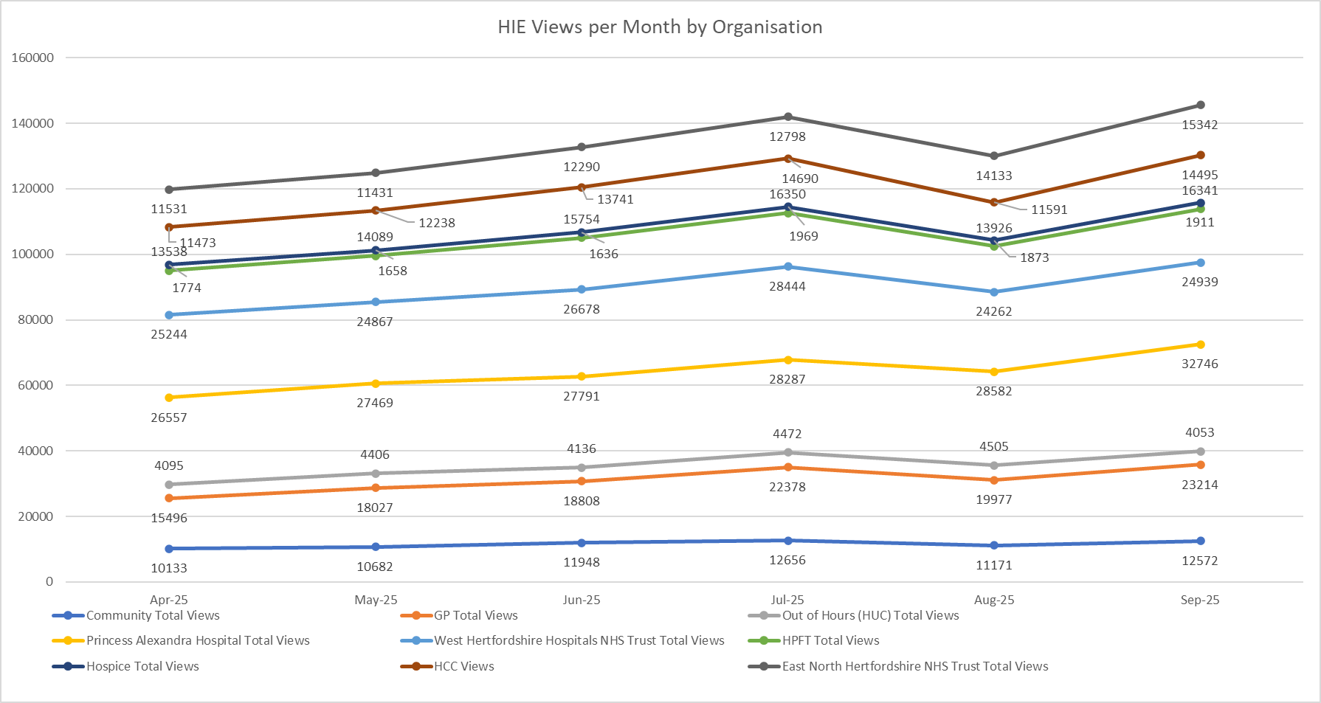
HWE Shared Care Record Utilisation - Overview

Slide 4
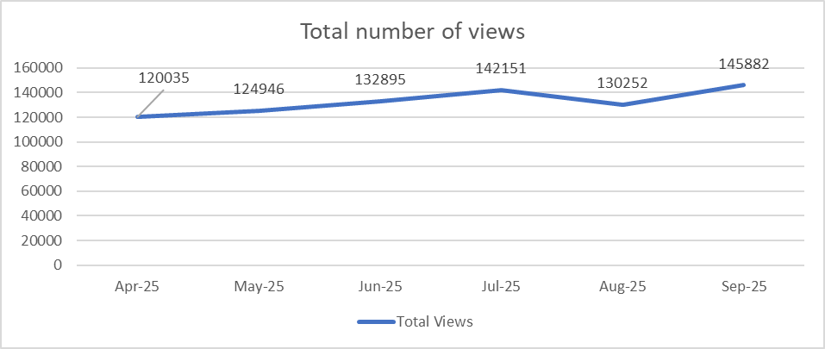
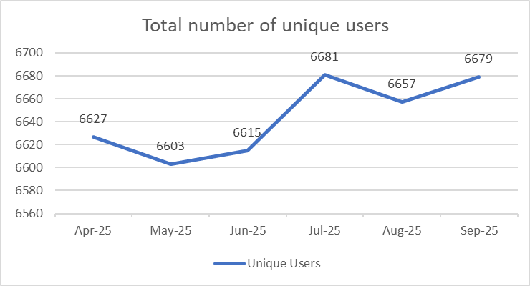
HWE Shared Care Record – Total Views and Unique Users

Slide 5
NHS Trusts
PAH, WHTH, ENHT, Mental Health & Learning Disability Trust HPFT

Slide 6
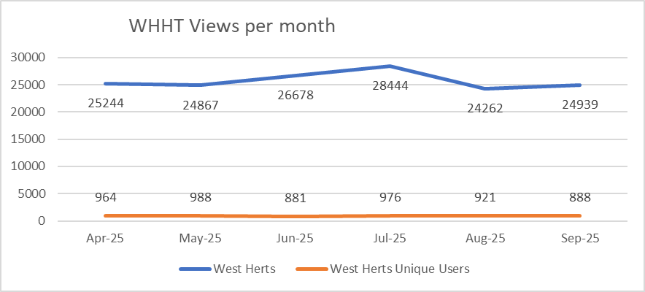
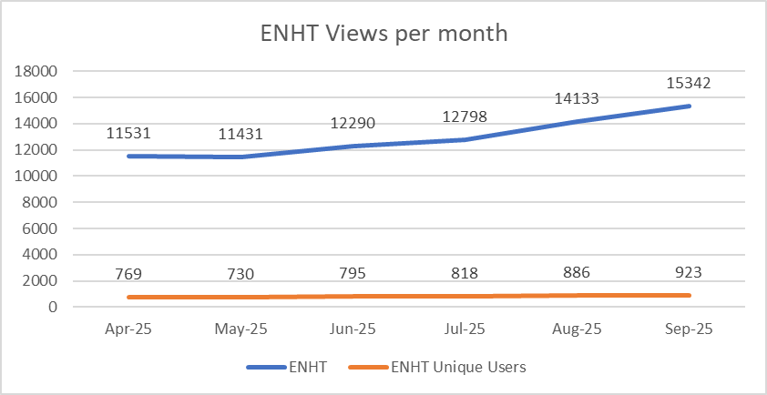
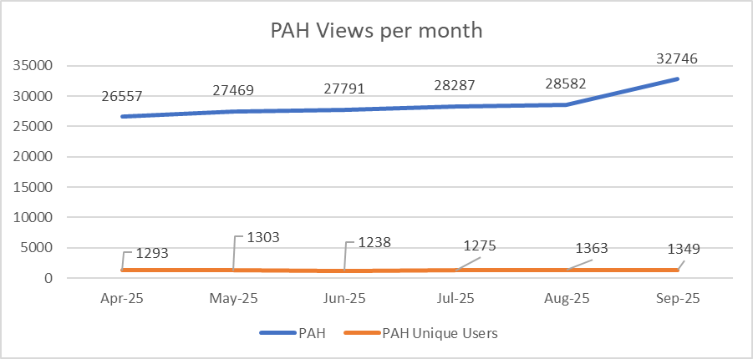
HWE ShCR Monthly Views and users insight - Acute
Provider | PAH | WHTH | ENHT
Average Views per User | 24 | 28 | 17

Slide 7
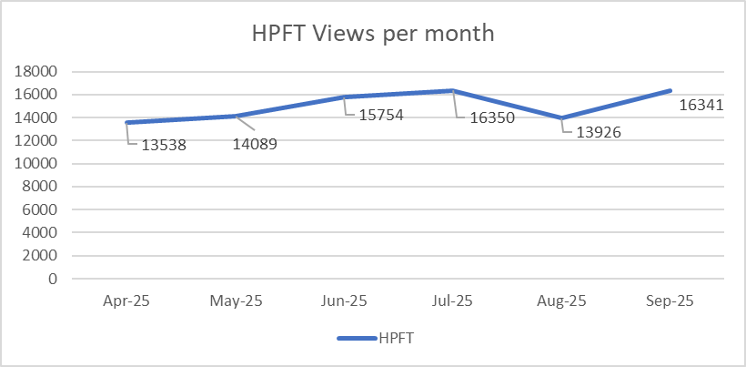
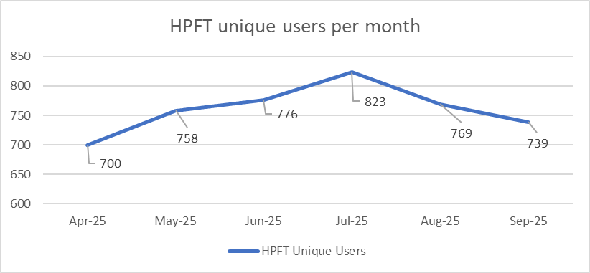
HWE ShCR Monthly Views Overview by Mental Health & Learning Disability Trust HPFT
Provider | HPFT
Average Views per User | 22

Slide 8
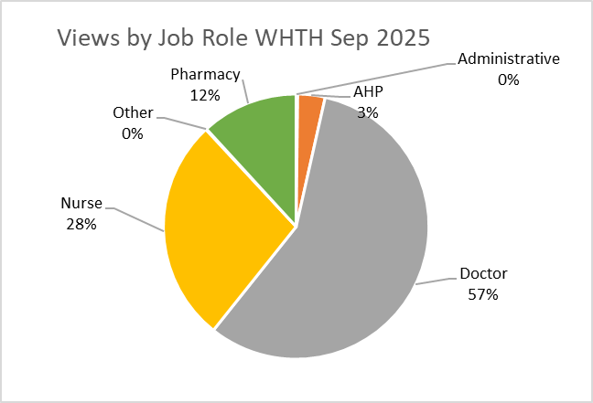
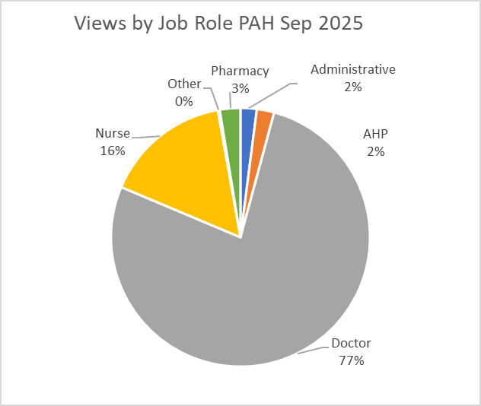
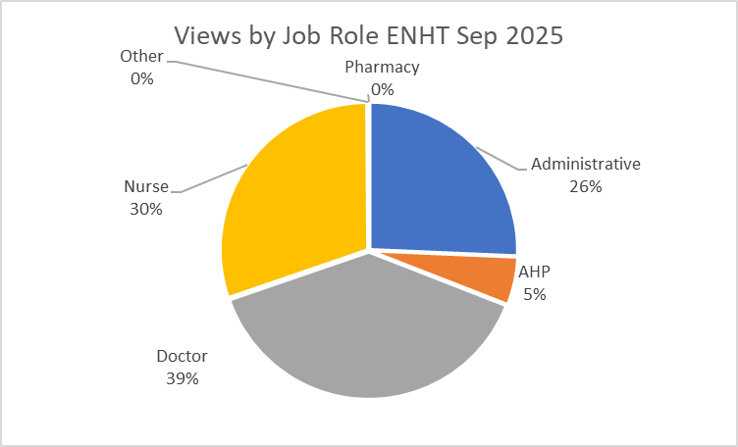
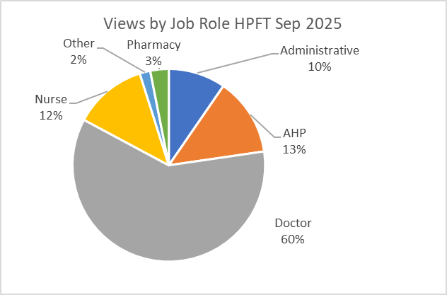
HWE ShCR Monthly Views Overview by Job Role – Acute and Mental Health
ENHT
WHTH
ENHT
HPFT

Slide 9
Community Providers

Slide 10
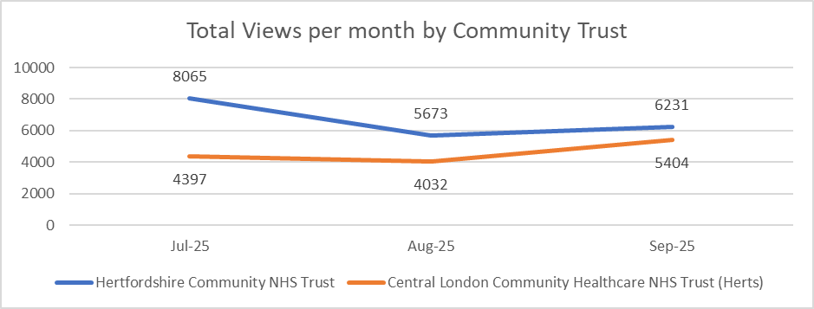
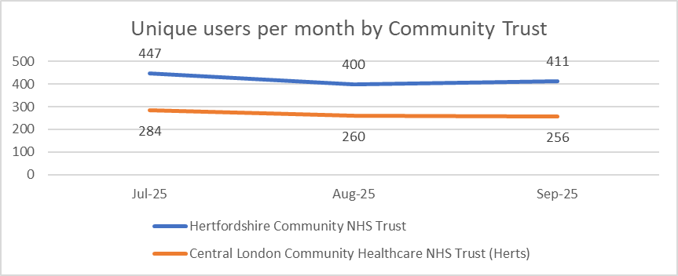
HWE ShCR Monthly Views Overview by Community Trusts
Provider | HCT | CLCH
Average Views per User | 15 | 21

Slide 11
HWE ShCR Monthly Views Overview - HCT
TPP Unit Description | Apr-25 | May-25 | Jun-25 | Jul-25 | Aug-25 | Sep-25
East & North Herts Respiratory Care Service | 339 | 424 | 433 | 584 | 190 | 260
Herts PHN - Dacorum and St Albans | 472 | 333 | 530 | 485 | 333 | 209
Herts PHN - Watford, 3 Rivers and Hertsmere | 108 | 151 | 141 | 152 | 78 | 130
West Herts Community Adult Health Service - St Albans & Harpenden | 263 | 309 | 320 | 285 | 395 | 332
Herts Valley Discharge Unit | 575 | 666 | 800 | 722 | 738 | 581
West Herts Specialist Palliative Care | 140 | 135 | 145 | 209 | 147 | 200
West Herts Heart Failure Service | 132 | 166 | 181 | 217 | 130 | 227
West Herts Community Adult Health Service - Dacorum | 394 | 479 | 446 | 368 | 528 | 476
West Herts Community Adult Health Service - Hertsmere | 368 | 360 | 304 | 354 | 297 | 517
West Herts Podiatry Service | 47 | 95 | 82 | 78 | 230 | 900
Herts Valley Community Treatment Unit | 109 | 111 | 142 | 176 | 30 | 14
Herts Valley Integrated Diabetes Service | 454 | 411 | 384 | 544 | 316 | 386
West Herts Community Adult Health Service - Watford | 357 | 344 | 360 | 358 | 230 | 414
Hertfordshire Diabetes Service | 114 | 179 | 143 | 123 | 87 | 174
East and North Herts Podiatry Service | 23 | 37 | 37 | 30 | 176 | 87
West Herts Nutrition & Dietetics | 190 | 212 | 270 | 386 | 190 | 439
West Herts Community Respiratory Service | 306 | 270 | 333 | 258 | 254 | 189
HCT Business Unit | 0 | 0 | 0 | 0 | 0 | 0
Herts Tissue Viability | 71 | 53 | 48 | 98 | 69 | 211

Slide 12
HWE ShCR Monthly Views Overview - HCT
TPP Unit Description | Apr-25 | May-25 | Jun-25 | Jul-25 | Aug-25 | Sep-25
West Herts Stroke Early Support Discharge | 238 | 213 | 220 | 270 | 238 | 329
HCT Prevention of admission | 1413 | 1498 | 1561 | 1543 | 1262 | 1000
West Herts Neuro Rehab Service | 297 | 273 | 268 | 251 | 122 | 117
West Herts Adult SALT Service | 162 | 155 | 184 | 146 | 51 | 102
East & North Herts Integ Comm Team - Welhat | 327 | 423 | 451 | 345 | 317 | 389
East and North Herts Adult Bladder & Bowel Care Service | 1 | 0 | 0 | 1 | 0 | 29
West Herts Community Hospitals | 378 | 453 | 542 | 508 | 509 | 401
East & North Herts Discharge Unit | 89 | 156 | 175 | 191 | 99 | 107
West Herts Lymphedema Service | 32 | 20 | 18 | 16 | 10 | 267
East & North Herts Integ Comm Team - Lower Lea Valley | 56 | 69 | 79 | 102 | 201 | 61
Central Midlands South CHIS | 0 | 4 | 0 | 6 | 42 | 21
Hertfordshire Musculoskeletal Service | 11 | 13 | 0 | 20 | 42 | 81
Hertfordshire Children's SLT Service | 0 | 0 | 1 | 1 | 0 | 42
HCT EPR Core - HCT | 31 | 32 | 193 | 129 | 29 | 105
West Herts Diabetes Retinal Screening Service | 342 | 390 | 640 | 1024 | 121 | 117
Herts PHN - East Herts, Broxbourne and Welhat | 121 | 121 | 211 | 111 | 131 | 93
Hertfordshire Community NHS PALMS Service | 11 | 14 | 22 | 24 | 35 | 246
West Herts Cardiac Rehab | 27 | 24 | 17 | 11 | 25 | 28
East & North Herts SLT Service Adults | 6 | 9 | 10 | 16 | 37 | 182
East & North Herts Nutrition and Dietetics Service | 5 | 10 | 20 | 36 | 52 | 26
East & North Herts Integ Comm Team - Upper Lea Valley | 225 | 200 | 265 | 253 | 189 | 210
Herts Step2 Mental Health and Emotional Wellbeing | 0 | 0 | 0 | 1 | 0 | 11
Herts PHN - North Herts and Stevenage | 124 | 117 | 140 | 132 | 71 | 138

Slide 13
HWE ShCR Monthly Views Overview - HCT
TPP Unit Description | Apr-25 | May-25 | Jun-25 | Jul-25 | Aug-25 | Sep-25
West Herts Stroke Early Support Discharge | 238 | 213 | 220 | 270 | 238 | 329
HCT Prevention of admission | 1413 | 1498 | 1561 | 1543 | 1262 | 1000
West Herts Neuro Rehab Service | 297 | 273 | 268 | 251 | 122 | 117
West Herts Adult SALT Service | 162 | 155 | 184 | 146 | 51 | 102
East & North Herts Integ Comm Team - Welhat | 327 | 423 | 451 | 345 | 317 | 389
East and North Herts Adult Bladder & Bowel Care Service | 1 | 0 | 0 | 1 | 0 | 29
West Herts Community Hospitals | 378 | 453 | 542 | 508 | 509 | 401
East & North Herts Discharge Unit | 89 | 156 | 175 | 191 | 99 | 107
West Herts Lymphedema Service | 32 | 20 | 18 | 16 | 10 | 267
East & North Herts Integ Comm Team - Lower Lea Valley | 56 | 69 | 79 | 102 | 201 | 61
Central Midlands South CHIS | 0 | 4 | 0 | 6 | 42 | 21
Hertfordshire Musculoskeletal Service | 11 | 13 | 0 | 20 | 42 | 81
Hertfordshire Children's SLT Service | 0 | 0 | 1 | 1 | 0 | 42
HCT EPR Core - HCT | 31 | 32 | 193 | 129 | 29 | 105
West Herts Diabetes Retinal Screening Service | 342 | 390 | 640 | 1024 | 121 | 117
Herts PHN - East Herts, Broxbourne and Welhat | 121 | 121 | 211 | 111 | 131 | 93
Hertfordshire Community NHS PALMS Service | 11 | 14 | 22 | 24 | 35 | 246
West Herts Cardiac Rehab | 27 | 24 | 17 | 11 | 25 | 28
East & North Herts SLT Service Adults | 6 | 9 | 10 | 16 | 37 | 182
East & North Herts Nutrition and Dietetics Service | 5 | 10 | 20 | 36 | 52 | 26
East & North Herts Integ Comm Team - Upper Lea Valley | 225 | 200 | 265 | 253 | 189 | 210
Herts Step2 Mental Health and Emotional Wellbeing | 0 | 0 | 0 | 1 | 0 | 11
Herts PHN - North Herts and Stevenage | 124 | 117 | 140 | 132 | 71 | 138

Slide 14
HWE ShCR Monthly Views Overview - HCT
TPP Unit Description | Apr-25 | May-25 | Jun-25 | Jul-25 | Aug-25 | Sep-25
Mental Health in Schools Team | 0 | 0 | 0 | 6 | 58 | 0
East & North Herts Integ Comm Team - Royston | 74 | 55 | 111 | 79 | 43 | 24
East & North Herts Integ Comm Team Stevenage | 326 | 202 | 330 | 355 | 338 | 314
East & North Herts Neuro Rehab Service | 54 | 75 | 97 | 162 | 82 | 88
Hertfordshire Children's OT & Physio Service | 65 | 56 | 61 | 91 | 36 | 57
West Herts Com Paeds | 1 | 0 | 2 | 0 | 49 | 9
North Herts & Stevenage PCT Reporting | 0 | 0 | 0 | 0 | 0 | 0
West Herts PCT Reporting Unit | 0 | 0 | 0 | 0 | 0 | 0
East and North Herts Community Hospitals | 8 | 3 | 2 | 1 | 2 | 9
East and North Herts Specialist Palliative Care | 108 | 132 | 95 | 148 | 164 | 116
East and North Herts Tissue Viability | 28 | 28 | 51 | 36 | 16 | 44
East & North Herts Clinical Navigator | 0 | 0 | 0 | 0 | 0 | 0
HCT Reporting | 0 | 0 | 0 | 0 | 0 | 0
East & North Herts Cheshunt Comm Hosp Nurses | 0 | 0 | 0 | 0 | 0 | 0
East & North Herts Integ Comm Team - Stort Valley and Villages | 27 | 33 | 25 | 15 | 44 | 217
East & North Herts Integ Comm Team - North Herts | 529 | 553 | 470 | 423 | 421 | 404
East & North Herts Stroke Early Support Discharge | 0 | 0 | 0 | 0 | 0 | 0
Herts and Essex Minor Injuries Unit | 0 | 0 | 0 | 0 | 0 | 0
East & North Herts Acute Therapy Services | 0 | 0 | 0 | 0 | 0 | 0
East & North Herts Cardiac Rehab Service | 35 | 37 | 47 | 62 | 6 | 1
East & North Herts Leg Ulcer Service | 127 | 95 | 81 | 137 | 86 | 54
East & North Herts Skin Health Service | 1 | 0 | 2 | 1 | 6 | 13
East and North Herts Lymphoedema Service | 10 | 26 | 18 | 11 | 28 | 16
Activate for Chronic Fatigue Syndrome & Persistent Pain Service | 0 | 0 | 0 | 0 | 0 | 0

Slide 15
HWE ShCR Monthly Views Overview - HCT
TPP Unit Description | Apr-25 | May-25 | Jun-25 | Jul-25 | Aug-25 | Sep-25
Herts Community Dental Service | 8 | 0 | 3 | 6 | 0 | 9
Herts Sickle Cell Service | 2 | 1 | 4 | 0 | 0 | 5
West Herts Children's Comm & Spec Nursing Service | 167 | 172 | 184 | 218 | 69 | 39
West Herts Special School Nurses and Herts Transitional 14-21 Service | 7 | 17 | 11 | 10 | 4 | 0
West Herts Children's Eye Care Service | 0 | 0 | 0 | 0 | 0 | 0
West Herts Paediatric Audiology Service | 0 | 0 | 0 | 0 | 0 | 12
Herts Children Looked After & Care Leavers Service | 17 | 31 | 12 | 19 | 118 | 136
HCT EPR Core - WHHT | 0 | 0 | 0 | 0 | 0 | 0
HCT EPR Core - ENHHT | 0 | 0 | 0 | 0 | 0 | 0
HCT EPR Core - HCC | 0 | 1 | 0 | 0 | 0 | 0
HCT - External EPR Core | 0 | 0 | 0 | 0 | 0 | 0
HCT Macmillan Brain CARE Team | 0 | 0 | 0 | 0 | 0 | 0
East and North Herts Maple Frailty service | 3 | 4 | 16 | 26 | 35 | 26
East and North Herts Phlebotomy Service | 0 | 0 | 0 | 0 | 0 | 0
West Herts Leg Ulcer Service | 0 | 0 | 0 | 0 | 0 | 6
West Herts Adult Bladder & Bowel Care Service | 0 | 11 | 7 | 12 | 3 | 13
East & North Herts Care Co-ordination Centre | 17 | 13 | 23 | 8 | 69 | 36
West Herts CLCH West Herts Palliative Care Referral Centre | 98 | 94 | 40 | 60 | 26 | 80
HCT CSAIS - Hertfordshire | 2 | 1 | 1 | 0 | 0 | 4
HCT Acute Respiratory Hub | 0 | 0 | 0 | 0 | 0 | 11
Unknown A | 0 | 0 | 1 | 12 | 1 | 44

Slide 16
Herts Urgent Care Out of Hours

Slide 17
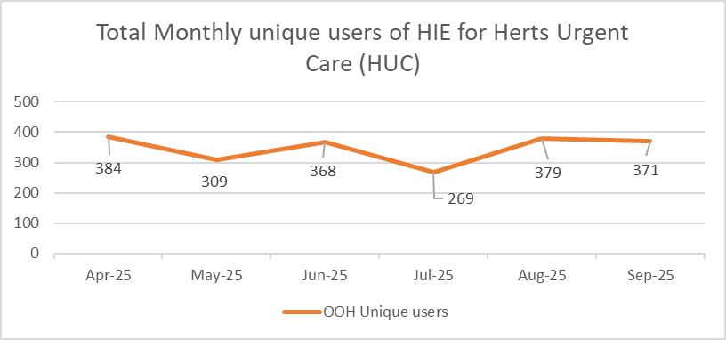
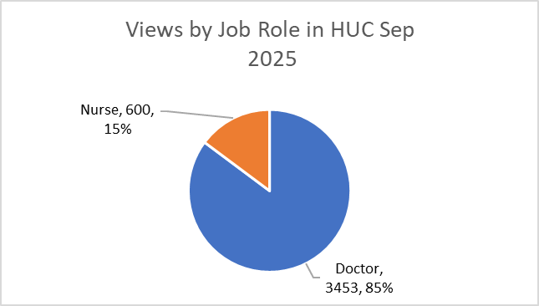
HWE ShCR Monthly Views Overview for Herts Urgent Care (HUC)
Provider | HUC
Average Views per User | 11

Slide 18
Hospice

Slide 19
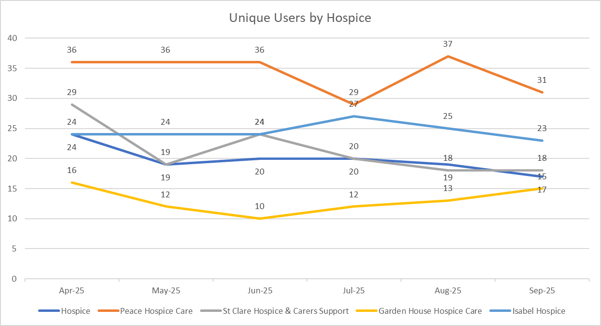
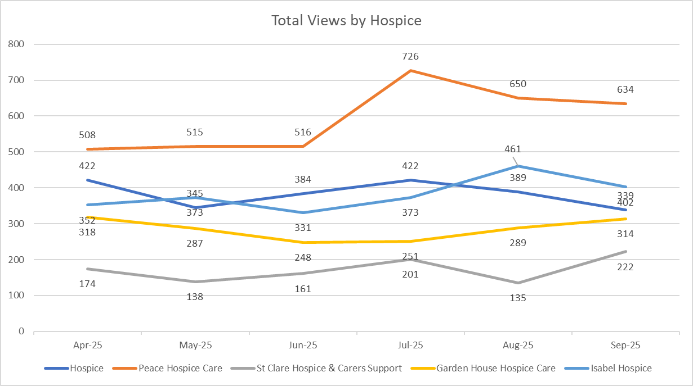
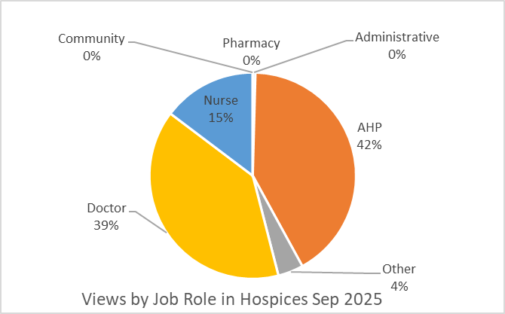
HWE ShCR Monthly Views Overview for Hospices

Slide 20
Hertfordshire County Council

Slide 21
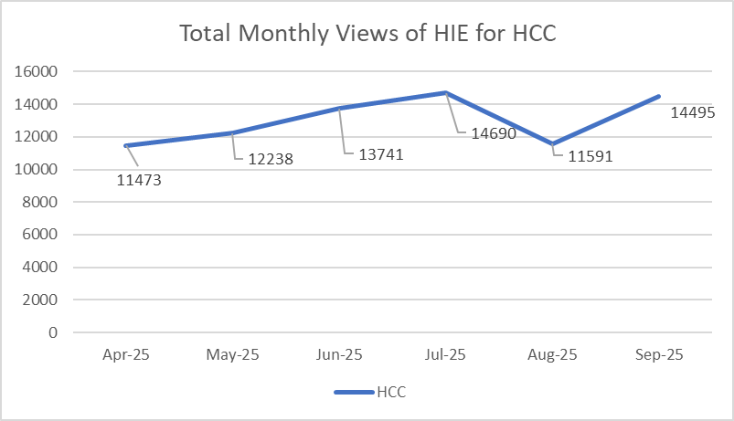
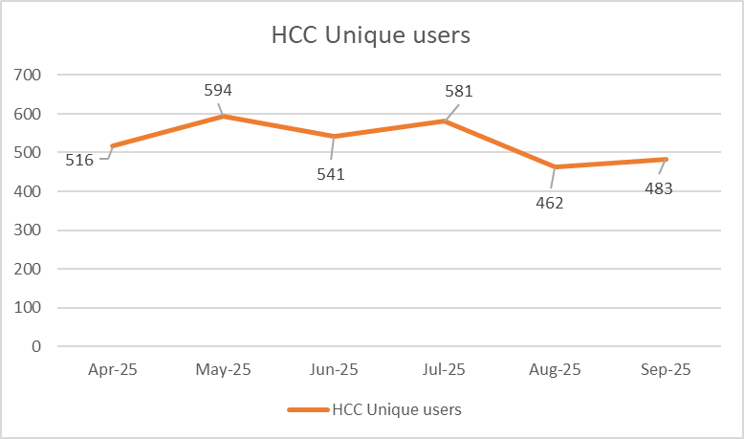
HWE ShCR Monthly Views Overview for Herts County Council (HCC)
Provider | HCC
Average Views per User | 30

Slide 22
GP Utilisation

Slide 23
HWE Shared Care Record Monthly Views Overview by Place
CCG | Jan-25 | Feb-25 | Mar-25 | Apr-25 | May-25 | Jun-25 | Jul-25 | Aug-25 | Sep-25
NHS Herts Valleys CCG | 9989 | 9838 | 11181 | 8517 | 9279 | 10135 | 12354 | 10351 | 11855
East & North Herts CCG | 4916 | 4503 | 5018 | 4097 | 5226 | 4633 | 5845 | 5421 | 6883
West Essex CCG | 4201 | 4401 | 5064 | 3245 | 4047 | 4281 | 4718 | 4094 | 4692
Total number of practices using | 118 | 121 | 121 | 120 | 119 | 119 | 120 | 122 | 122
% of practices using | 91% | 93% | 93% | 92% | 92% | 92% | 92% | 94% | 94%

